Slide 1


Version Control Systems
Version control systems (VCS) are crucial for software development and collaborative projects. They track changes to files over time, making it easy to revert to previous versions, see what changes were made, and collaborate with others.

Slide 2

Features of Version Control System
Track Changes
Revert to Previous Versions
Version control systems record every change made to files in a project, creating a complete history of development.
If a mistake is made or a feature needs to be rolled back, you can easily revert to any previous version of the code.
Collaboration
Branching
Multiple developers can work on the same project simultaneously, with version control managing their changes and preventing conflicts.
Version control allows you to create separate branches of development, enabling teams to work on different features or bug fixes independently.

Slide 3
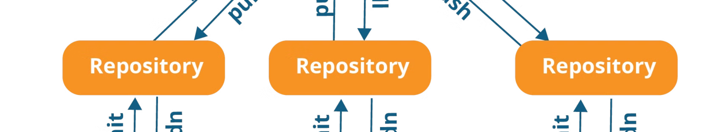
Version Control Systems
1
Benefits of VCS
2
Disadvantages of VCS
Version control systems offer many benefits, including:
Change Tracking, Supports parallel development and feature integration, Maintains a detailed history of changes and enables reversion to previous versions, Collaboration, Ensures data protection and recovery, Assists in auditing and regulatory compliance.
Version control systems few disadvantages, including:
Complexity, Resource Intensive, Merge Conflicts.

Slide 4

Working of VCS
1
Local Changes
Users make changes to their local copy of the repository.
2
Commit
Changes are committed to the local repository, creating a new version.
3
Push
Committed changes are pushed to a central repository, making them available to others.
4
Pull
Users can pull updates from the central repository to sync their local copy with the latest changes.
5
Branching & Merging
Users create branches to work on features independently. Changes are merged back into the main branch once complete.

Slide 5
Types of Version Control Systems
Centralized
Distributed
A single server stores all project files. Examples: Subversion, CVS.
Feature: All files and version history are stored in a single central server.
Advantage: Simplifies management with a single source of truth.
Disadvantage: Prone to single points of failure if the central server is inaccessible.
Each developer has a complete copy of the project, enabling offline work and faster collaboration. Example: Git.
Feature: Every contributor has a complete local copy of the repository, including its full history.
Advantage: Enhances collaboration and resilience, allowing work offline and mitigating central server failures.
Disadvantage: Can be more complex to manage due to multiple copies and synchronization needs.

Slide 6
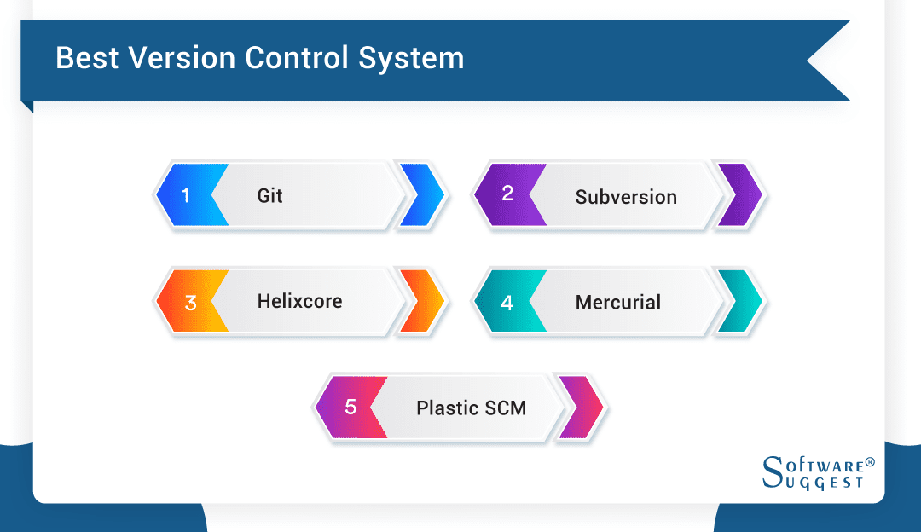
Popular Version Control Systems Tools
1
Concurrent Versions System (CVS)
Introduced in 1990.Early version control system with basic change tracking; limited by its age and lack of modern features.
2
Subversion (SVN)
Released in 2000. Enhanced centralized system with better branching; however, still centralized, which can limit flexibility.
3
Mercurial
Launched in 2005, utilizes a centralized model. Centralized system known for speed and simplicity; less popular compared to Git.
4
Git
Developed in 2005, employs a decentralized model. Decentralized, highly flexible, and widely adopted for distributed development; may have a steeper learning curve.

Slide 7
Why Version Control Systems?
In previous time, when we work on a software development project we use to write different codes manually, merge that & compile. Imagine trying to keep track of every change made to a project manually. This would be extremely tedious and error-prone.
It is very hard for a manager to remember who is giving which code. So, to merge that codes we used a tool instead of person i.e. Software Configuration Management or Source Code Management. It is used to manage versions of code, giving versions to codes to remember file.
A VCS is essential for managing changes in software projects, facilitating collaboration, ensuring code integrity, enabling backup and recovery, and maintaining a history of changes for audit and compliance.

Slide 8
History of Version Control Systems
1970s:
Early version control concepts emerged, focused on managing source code.
Simple tools like SCCS (Source Code Control System) were introduced to track changes in files.
1980s:
RCS (Revision Control System) was developed, improving file-based version control by allowing multiple revisions and branching.
These early systems were centralized, requiring all changes to be stored on a central server.
1990s:
Centralized version control systems like CVS (Concurrent Versions System) and Subversion (SVN) gained popularity, enabling better collaboration between teams.
These tools allowed multiple developers to work on the same project by maintaining a central repository.
2000s:
Distributed version control systems (DVCS) like Git and Mercurial were introduced, revolutionizing version control by allowing each developer to have a full copy of the repository.
Git, created by Linus Torvalds, became widely popular due to its speed, flexibility, and strong branching and merging capabilities.
2010s to Present:
Git became the de facto standard for version control, with platforms like GitHub, GitLab, and Bitbucket enhancing Git’s collaboration features through hosted repositories and pull requests.
Version control systems expanded beyond code management to support infrastructure-as-code and configuration management in DevOps workflows. Integration with CI/CD tools is now a key aspect of modern version control.

Slide 9
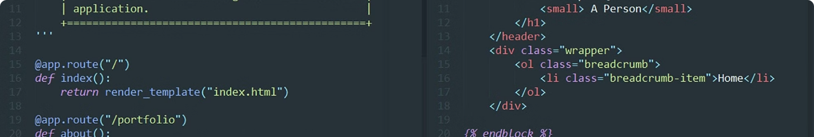
Best Practices for Effective Version Control
1
Commit Early and Often
2
Write Meaningful Commit Messages
Make small, frequent commits to ensure that your changes are tracked and that you have a clear history of development.
Provide clear and concise explanations of the changes made in each commit to make it easier for others to understand the development process.
3
Use Branches Effectively
4
Review Code Regularly
Create separate branches for different features or bug fixes to avoid conflicts and maintain a clear separation of work.
Encourage code reviews to ensure that changes are well-tested, maintain code quality, and prevent bugs.

Slide 10
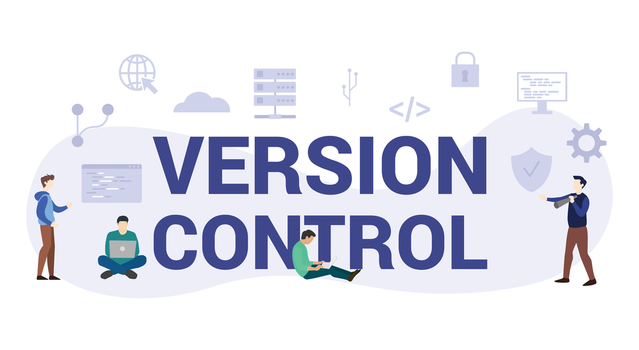
Version Control Services (VCS)
Definition of VCS
Features of VCS
Benefits of VCS
Disadvantages of VCS
Fully managed cloud platforms hosting version-controlled repositories, often offering enhanced features beyond basic hosting. Git is the predominant choice, making these services commonly referred to as "Git providers.
Backup and Recovery: Version Control Services provide a backup of your entire project, ensuring that you can recover from any mistakes or failures by reverting to previous versions.
Distributed Development: VCS enables team members to work on different parts of a project simultaneously, allowing for faster development without the risk of overwriting or losing work.
Fully managed with integrated features.
Simplifies collaboration and continuous integration.
Reliant on third-party providers for data security and uptime.

Slide 11
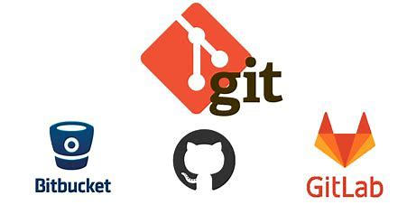
Popular Version Control Systems Providers
1
GitHub
Owned by Microsoft; the most popular choice with extensive features for collaboration and integration.
2
GitLab
A strong competitor to GitHub, known for its DevOps and CI/CD capabilities.
3
BitBucket
Owned by Atlassian; integrates well with other Atlassian tools like Jira.
4
SourceForge
An early platform for open-source projects, less popular today but still in use.

Slide 12
CVCS vs DVCS
Feature | Centralized Version Control System (CVCS) | Distributed Version Control System (DVCS)
Repository Structure | Single central repository | Each user has a complete local repository
Examples | Subversion (SVN), Perforce | Git, Mercurial
Single Point of Failure | Yes | No
Offline Work | Limited | Extensive
Performance | Dependent on network speed | Faster due to local operations
Collaboration | Centralized, simpler but less flexible | Decentralized, supports complex workflows
Complexity | Simpler to use and understand | More complex, especially for beginners
Disk Space Requirements | Less, as only one central repository | More, as each user has a full repository copy
Backup and Recovery | More vulnerable, single backup needed | More resilient, multiple backups available
Merge Handling | Typically more difficult | More efficient and powerful
Commit History | Stored only in the central repository | Full history available locally for each user
Branching and Merging | Less efficient | Highly efficient and flexible
Example of Usage | Smaller teams, simpler projects | Large projects, distributed teams

Slide 13
Git vs SVN
Feature | Git | SVN (Subversion)
Type | Distributed Version Control System | Centralized Version Control System
Repository Structure | Each user has a complete local repo | Single central repository
Offline Work | Full support for offline work | Limited offline capabilities
Branching and Merging | Lightweight, efficient, flexible | Heavier, less flexible
Merge Handling | Automatic and efficient | More manual conflict resolution
Performance | Fast due to local operations | Dependent on network speed
History | Full history available locally | History stored on central server
Storage Requirements | Higher due to full local copies | Lower, central storage
Learning Curve | Steeper, more complex | Simpler, easier for beginners
Example of Use | Large projects, distributed teams | Smaller teams, simpler projects

Slide 14
Git vs Mercurial
Feature | Git | Mercurial
Type | Distributed Version Control System | Distributed Version Control System
Repository Structure | Each user has a complete local repo | Each user has a complete local repo
Offline Work | Full support for offline work | Full support for offline work
Branching and Merging | More flexible, but complex | Simpler, but less flexible
Performance | Fast due to local operations | Fast due to local operations
Merge Handling | More efficient | Efficient, but simpler
History | Full history available locally | Full history available locally
Storage Requirements | Higher due to full local copies | Higher due to full local copies
Learning Curve | Steeper, more complex | Gentler, simpler to learn
Example of Use | Large projects, complex workflows | Large projects, user-friendly
Tooling and Extensions | Rich ecosystem of tools and extensions | Fewer, but growing ecosystem

Slide 15
Git vs CVS
Aspect | Git | CVS (Concurrent Versions System)
Type | Distributed Version Control System (DVCS) | Centralized Version Control System (CVCS)
Repository Structure | Each user has a full local copy of the repo | A single central repository with no local copies
Branching | Easy, lightweight, encourages frequent use | Difficult, often avoided due to complexity
Merging | Advanced merging capabilities | Limited, with more manual conflict resolution
Speed | Fast operations, especially for local tasks | Slower due to reliance on a central server
Offline Work | Full functionality available offline | Requires connection to the central server
Data Integrity | Ensures integrity with cryptographic hashing | Less focus on data integrity
Learning Curve | Steeper, due to flexibility and features | Simpler, but with fewer features and flexibility
Popularity | Widely used in modern development | Largely outdated, rarely used today
Community Support | Large, active community and extensive resources | Limited support, as it is mostly obsolete

Slide 16
Git vs GitHub
Feature | Git | GitHub
Type | Version Control System | Hosting service for Git repositories
Repository Structure | Each user has a complete local repo | Hosts Git repositories centrally
Functionality | Version control, branching, merging | Collaboration, code review, CI/CD
Offline Work | Full support for offline work | Requires internet for access
Access Control | Managed locally or via hosting service | Managed via GitHub platform
User Interface | Command-line, various GUIs | Web-based interface, integrations
Collaboration | Peer-to-peer collaboration | Centralized collaboration via web
Community Features | No built-in community features | Pull requests, issues, wikis, discussions
Integration | Requires third-party tools | Built-in integrations with CI/CD, apps
Example of Use | Local version control, development | Open source projects, team collaboration

Slide 17
GitHub, GitLab, BitBucket and SourceForge
Feature | GitHub | GitLab | BitBucket | SourceForge
Ownership | Microsoft | GitLab Inc. | Atlassian | Slashdot Media
Primary Focus | Social coding, open-source & private | DevOps, CI/CD, end-to-end DevOps | Integration with Atlassian tools | Hosting open-source projects
CI/CD Integration | GitHub Actions | Built-in CI/CD | BitBucket Pipelines | Limited native CI/CD features
User Interface | User-friendly, popular UI | Advanced with built-in DevOps tools | Clean, integrates with Jira | Outdated compared to competitors
Repository Limitations | Unlimited public and private repos | Unlimited public and private repos | Unlimited public, private limits for free plans | Unlimited for open-source, restricted for private
Authentication | OAuth, SAML, 2FA, GitHub Enterprise | OAuth, SAML, 2FA, GitLab Ultimate | OAuth, SAML, 2FA, BitBucket Premium | OAuth, Basic Authentication
Integration Support | Extensive integrations & marketplace | Strong CI/CD & DevOps tool integration | Strong with Atlassian products | Limited compared to modern platforms
Community Support | Large, active open-source community | Growing, strong in DevOps | Popular among enterprise teams | Known for historical open-source projects
Pricing | Free for public/private with paid options | Free tier with paid plans | Free tier with paid plans | Free for open-source, paid for private
Notable Weakness | Reliance on GitHub Actions for CI/CD | Can be overwhelming for small teams | Private repos restricted on free tier | Outdated UI and less active community

